Slide 1
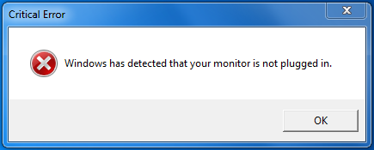
VGP104 - Software Development and Testing
Instructor: Peter Chan

Slide 2
Agenda
Different Types of Errors
Using the Debugger
Rule #2 - Make It Fail

Slide 3
Different Types of Errors
Syntax Errors
Linker Errors
Runtime Errors

Slide 4
Syntax Errors
Found during compilation
The compiler found a symbol that it wasn't expecting or that it thinks is missing
Can be caused by mismatched number of parentheses, misplaced semicolon, etc

Slide 5
Linker Errors
Functions or libraries that is needed cannot be found
Unresolved external symbols
Can be caused by misspelling the name of functions, missing files
Cannot find the main() function

Slide 6
Runtime Errors
Only occurs when you run the program
Two types: Fatal Errors and Logic Errors
Division by zero, bad pointers, index out of bound, etc
Program does not function as designed

Slide 7
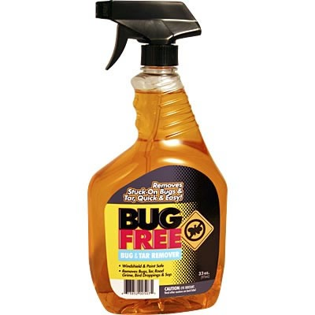
Using the Debugger

Slide 8
Tools
Local, Auto, Watch Windows
Callstack
Output Window
Memory Viewer
Disassembly

Slide 9
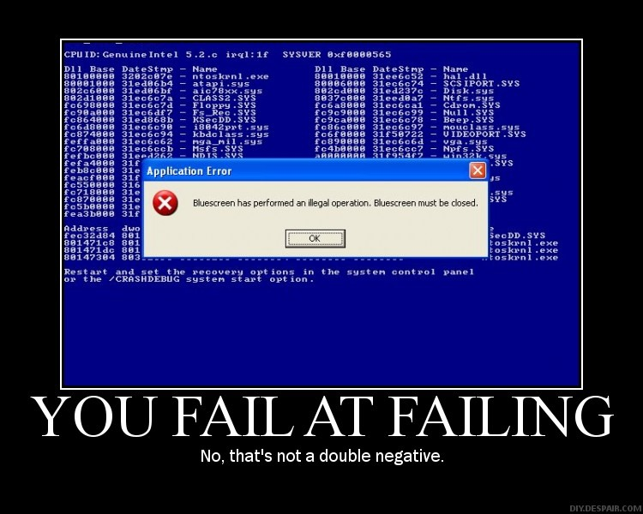
Rule #2 - Make It Fail

Slide 10
Rule #2 - Make It Fail
Bug reports often include repro steps and rate of occurrence
Knowing the conditions that make it fail can help you focus on the probable causes
Having a surefire way to make it fail allows you to tell if you have fixed it

Slide 11
Rule #2 - Make It Fail
Stimulate the failure
Sometimes errors occur only after a large number of repetitions
Don't simulate the failure
"But it works for me!"
Incorrect assumptions and change of conditions can hide the problem

